Slide 1
ECON 672
Week 8: Difference-in-Differences
Samuel Rowe, PhD 1/19/2023

Slide 2
Overview
The Takeaway
Background of Diff-in-Diff
Estimator
DD Example: Minimum Wage
Sample Averages vs Regressions
Inference
Testing Assumptions
Diff-in-Diff and Triple Difference Examples

Slide 3
Overview
Difference-in-Differences
The difference-in-differences estimator (or diff-in-diff) is a very common estimator used in academic research
Not utilized enough in federal evaluation
It can handle observed and unobserved heterogeneity/confounders
Fixed Effects estimator only handles time-invariant confounders
Diff-in-diff can handle both time-invariant and time-varying confounders, as long as the parallel assumption holds

Slide 4
The Takeaway
Difference-in-Differences
Strengths
An identification strategy that can handle both time-invariant and time-varying confounders both observed and unobserved
It’s a powerful, yet simple identification strategy
We can indirectly test the main assumption, but not quite as robust as RDD
Weaknesses
The diff-in-diff estimator only estimates the ATT and not the ATE
We have a dichotomous issue with our bias-variance tradeoff
When we have more than 1 treatment group, we may have biased coefficient if adoption time varies
When we have only 1 treatment group, we may have inconsistent and biased errors and higher rejection rate of a true null (Type I Errors)

Slide 5
The Takeaway
Difference-in-Differences
Assumptions
Parallel Trends assumption is our main assumption
The trends of the control group are the true counterfactual trends of the treatment group
Stable Unit Treatment Value Assumption
There is no spillover from treatment onto control group
This is a bit more concern with triple difference-in-difference-in-differences due to contamination within-treatment group

Slide 6
The Takeaway
Difference-in-Differences
Testable Assumptions
Parallel trends assumption is not directly testable, since we can never observe the counterfactual
We have three types of indirect tests of the parallel trends assumption
Pre-treatment balance - plotting or descriptive statistics
Event Studies - pre-treatment leads and lags
Placebo - Falsification tests including Triple DDD

Slide 7
Thorny Issue
Difference-in-Differences
Just restating the weakness
If we only have 1 or 2 treatment groups, our standard errors will like be inconsistent and biased
This will result in rejecting the true null hypothesis
However, our estimate will be biased if we have multiple treatment groups that vary in time adoption
If treatment is adopted at the same time, then this is less of a concern

Slide 8
Background
Difference-in-Differences

Slide 9
Background
Difference-in-Differences
John Snow (1855) famous cholera study
He utilized a rudimentary difference-in-differences study design to study London’s cholera outbreaks
Snow had a theory that cholera was not an inanimate object but a living organism that entered the body through food and water
Snow’s results help show that cholera is transmitted through water and not air
Most good Diff-in-Diff come from “natural experiments”
There is a naturally occurring variation in treatment that affects only some units over time

Slide 10
Background
Difference-in-Differences
In 1800s London, there were several water companies that supplied water to different parts of the city
They typically took water from the Thames, which was polluted from human waste including bodily waste
In 1849, the Lambeth company moved their intake pipes upriver along the Thames before human waste polluted the water
Snow utilizes this change to observe if cholera changes for customers of Lambeth
If cholera is water transmitted then Lambeth should have lower death rates of cholera

Slide 11
Background
Difference-in-Differences
Snow uses Southwark and Vauxhall Waterworks Company as the counterfactual for Lambeth
Snow documents the similarities between Southwark/Vauxhall and Lambeth, so Southwark/Vauxhall is a true counterfactual of Lambeth
Snow meticulously collected data on water consumption company going door to door, and he matches households with city level cholera death
The only difference should be what water the households drank between treatment (Lambeth) and control (Southwark/Vauxhall)

Slide 12
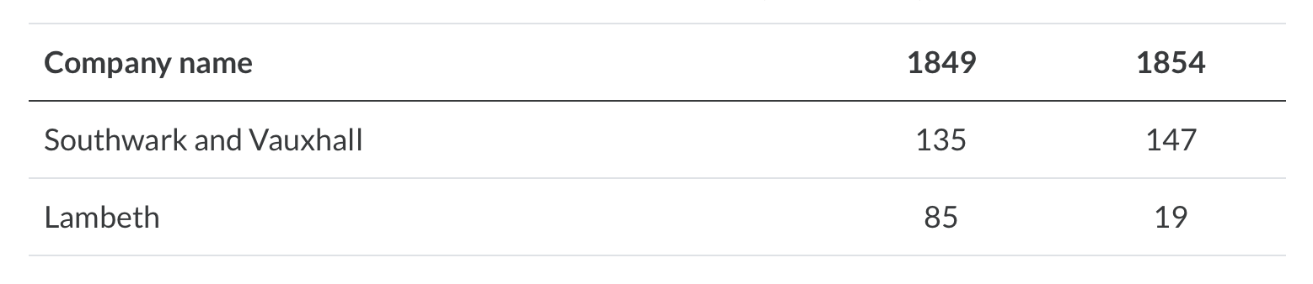
Background
Difference-in-Differences
In 1849, there were 135 cases of cholera out of 10,000 households for Southwark/Vauxhall and 85 cases out of 10,000 households for Lambeth
In 1854, there were 147 cases per 10,000 households for Southwark/Vauxhall and 19 cases per 10,000 households for Lambeth
We can calculate an ATT of 78 fewer deaths per household
This resulted in the reject of cholera as an airborne disease and saved lives

Slide 13
Estimator
Difference-in-Differences
Our simple case Difference-in-Difference estimator will be a 2-by-2 Diff-in-Diff
We will get into more complex Diff-in-Diff estimators next week
We are usually using panel data not cross-sectional data
You can use cross-sectional data but you run the risk of compositional changes
The basis
Difference before and after in the treatment group
Difference before and after in the control group
Difference the differences to get an estimate of ATT

Slide 14
Estimator
Difference-in-Differences
We need repeated observations over time for both the treatment and control
We use the first difference to get rid of observed and unobserved time-invariant confounders (like Fixed Effects)
We use the second difference to control for observed and unobserved time-varying confounders (with the parallel trends assumption)
We eliminate selection bias with the pre-post comparisons
As long as the parallel trends assumption holds

Slide 15
Estimator
Difference-in-Differences
The basis of 2x2 DD
We have a mean outcome before and a mean outcome after the treatment for the treatment group $k$
We have a mean outcome before and a mean outcome after the treatment for the control group $U$
$${\overset{̂}{δ}}_{kU}^{2x2}=({\overline{y}}_{k}^{post(k)}-{\overline{y}}_{k}^{pre(k)})-({\overline{y}}_{U}^{post(U)}-{\overline{y}}_{U}^{pre(U)})$$
${\overset{̂}{δ}}_{kU}^{2x2}$ is the estimator for the ATT

Slide 16
Estimator
Difference-in-Differences
What is being estimated?
$${\overset{̂}{δ}}_{kU}^{2x2}=(E[Y_{k}|Post]-E[Y_{k}|Pre])-(E[Y_{U}|Post]-E[Y_{U}|Pre])$$
Use potential outcome and add a zero ${\overset{̂}{δ}}_{kU}^{2x2}=\underset{\text{Switching Equation}}{\underset{⏟}{(E[Y_{k}^{1}|Post]-E[Y_{k}^{0}|Pre])-(E[Y_{U}^{0}|Post]-E[Y_{U}^{0}|Pre])}}+0$ $\underset{\text{equals 0}}{\underset{⏟}{E[Y_{k}^{0}|Post]-E[Y_{k}^{0}|Post]}}$

Slide 17
Estimator
Difference-in-Differences
$${\overset{̂}{δ}}_{kU}^{2x2}=(E[Y_{k}^{1}|Post]-E[Y_{k}^{0}|Pre])-(E[Y_{U}^{0}|Post]-E[Y_{U}^{0}|Pre])+E[Y_{k}^{0}|Post]-E[Y_{k}^{0}|Post]$$
We can rearrange to get ATT and Parallel Trends Assumption
${\overset{̂}{δ}}_{kU}^{2x2}=\underset{\text{ATT}}{\underset{⏟}{E[Y_{k}^{1}|Post]-E[Y_{k}^{0}|Post]}}$ $+\underset{\text{Non-Parallel Trends Bias in 2x2 Case}}{\underset{⏟}{[E[Y_{k}^{0}|Post]-E[Y_{k}^{0}|Pre]]-[E[Y_{U}^{0}|Post]-E[Y_{U}^{0}|Pre]]}}$

Slide 18
Estimator
Difference-in-Differences
Let’s decompose the second term
${\overset{̂}{δ}}_{kU}^{2x2}=ATT+NonParallelTrendsBias$ $=ATT+\underset{\text{Non-Parallel Trends Bias in 2x2 Case}}{\underset{⏟}{[E[Y_{k}^{0}|Post]-E[Y_{k}^{0}|Pre]]-[E[Y_{U}^{0}|Post]-E[Y_{U}^{0}|Pre]]}}$ $=ATT+[\underset{\text{Treatment Trends}}{\underset{⏟}{\underset{\text{Counterfactual}}{\underset{⏟}{E[Y_{k}^{0}|Post]}}-E[Y_{k}^{0}|Pre]]}}-\underset{\text{Control Trend}}{\underset{⏟}{[E[Y_{U}^{0}|Post]-E[Y_{U}^{0}|Pre]]}}$

Slide 19
Estimator
Difference-in-Differences
If trends are not the same between treatment and control
$${\overset{̂}{δ}}_{kU}^{2x2}=ATT+NonParallelTrendsBias$$
If trends are the same between treatment and control
${\overset{̂}{δ}}_{kU}^{2x2}=ATT+0$ and ${\overset{̂}{δ}}_{kU}^{2x2}=δ_{ATT}$
We cannot directly test the parallel trends assumption, since we cannot observe the counterfactual, $E[Y_{k}^{0}|Post]$
We assume that the trend in the control is the same as the treatment and we extrapolate $E[Y_{k}^{0}|Post]$ from this trend

Slide 20
Minimum Wage and Diff-in-Diff
Example

Slide 21
Minimum Wage and Diff-in-Diff
Example
The classic minimum wage study by Card and Krueger (1994)
The authors utilize a difference-in-difference design to study the impact of minimum wage on employment
The authors found an ATT effect of a 2.76 increase in full-time employment
It challenged what economists think about minimum wage and negative impact on employment
If the labor market was perfectly competitive, then employment would have declined
There was a lot of backlash due to economists having their priors challenged, but it provided a solid research design to counter the status quo model

Slide 22
Minimum Wage and Diff-in-Diff
Example
Research Question: what is the impact of minimum wage on employment?
Theory suggests that in a perfectly competitive labor market, minimum wage will create a deadweight loss and decrease employment
In a monopsony, minimum wages can increase employment
The impact of minimum wage may depend on the context of local labor markets

Slide 23
Minimum Wage and Diff-in-Diff
Example
Data Methodology
There is a lack of randomized assignment for minimum wage, so Card and Krueger (1994) analyzes the labor market in New Jersey near the border of Pennsylvania, and utilize a design fairly close to Snow (1855)
They compare New Jersey with Pennsylvania before and after New Jersey increases its state-level minimum wage from $4.25 to $5.05
They surveyed over 400 fast-food establishments in both states near the border in February 1992 before the policy and in November 1992 after the policy

Slide 24
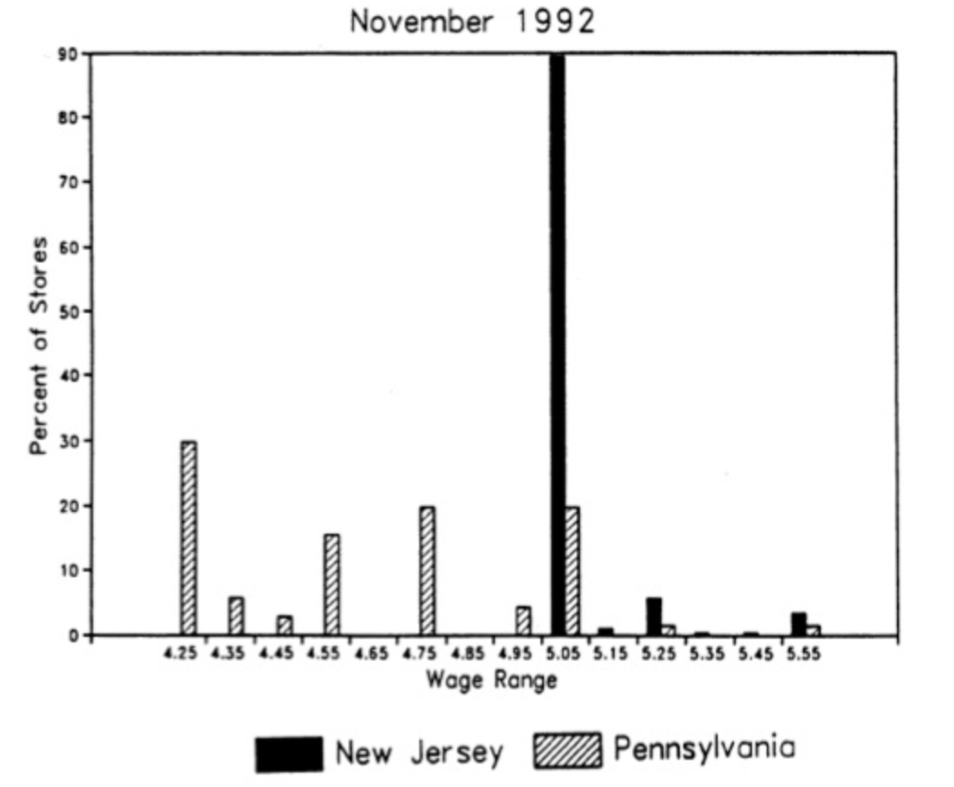
Minimum Wage and Diff-in-Diff
Example
The policy appeared to have been binding and establishments complied with the new state-level minimum wage in New Jersey (kind of like a 1st Stage)

Slide 25
Minimum Wage and Diff-in-Diff
Example
What are we estimating?
The average treatment effect on the treated (NJ) for minimum wage on employment
${\overset{̂}{δ}}_{NJ,PA}^{2x2}=\underset{\text{ATT}}{\underset{⏟}{E[Y_{NJ}^{1}|Post]-E[Y_{NJ}^{0}|Post]}}$ $+\underset{\text{Non-Parallel Trends Bias in 2x2 Case}}{\underset{⏟}{[E[Y_{NJ}^{0}|Post]-E[Y_{NJ}^{0}|Pre]]-[E[Y_{PA}^{0}|Post]-E[Y_{PA}^{0}|Pre]]}}$

Slide 26
Minimum Wage and Diff-in-Diff
Example
Results
Our estimated ATT is 2.76 full-time employment
Table 1
NJ | Before | After | 1st Difference
 | 20.44 | 21.03 | 0.59
 | (0.51) | (0.52) | (0.54)
PA | Before | After | 1st Difference
 | 23.3 | 21.147 | -2.16
 | (0.94) | (1.35) | (1.25)
 |  |  | 2nd Difference
 |  |  | 2.76
 |  |  | (1.36)

Slide 27
Sample Average vs Regressions
You can use sample average pre-post for difference-in-differences
You can also use regressions as well
You will get 3 of out of the 4 dummies in our regression (we need to exclude one for the intercept)
You can use covariates to increase precision around your DD estimate
It’s a good idea to use specification tests for your Diff-in-Diff estimator with and without covariates to see how sensitive your estimate is

Slide 28
Sample Average vs Regressions
Regression
Difference-in-Difference 2x2 case Regression (Using NJ-PA Example)
$$Y_{its}=α+γNJ_{s}+λD_{t}+δ(NJ×D)_{st}+ε_{its}$$
Where $i$ is individual in state $s$ in time period $t$
Where $NJ_{s}=1$ if the observation lives in NJ
Where $D_{t}=1$ if the observation is in the POST period or November 1992

Slide 29
Sample Average vs Regressions
Decomposition of the Regression
Difference-in-Difference 2x2 case Regression (Using NJ-PA Example)
$$Y_{its}=α+γNJ_{s}+λD_{t}+δ(NJ×D)_{st}+ε_{its}$$
PA Pre: $α$
PA Post: $α+λ$
NJ Pre: $α+γ$
NJ Post: $α+γ+λ+δ$
DD | Post | Pre | Difference
NJ
PA
Second Difference
$$α+γ+λ+δ$$
$$α+γ$$
$$λ+δ$$
$$α+λ$$
$$α$$
$$λ$$
$$δ$$

Slide 30
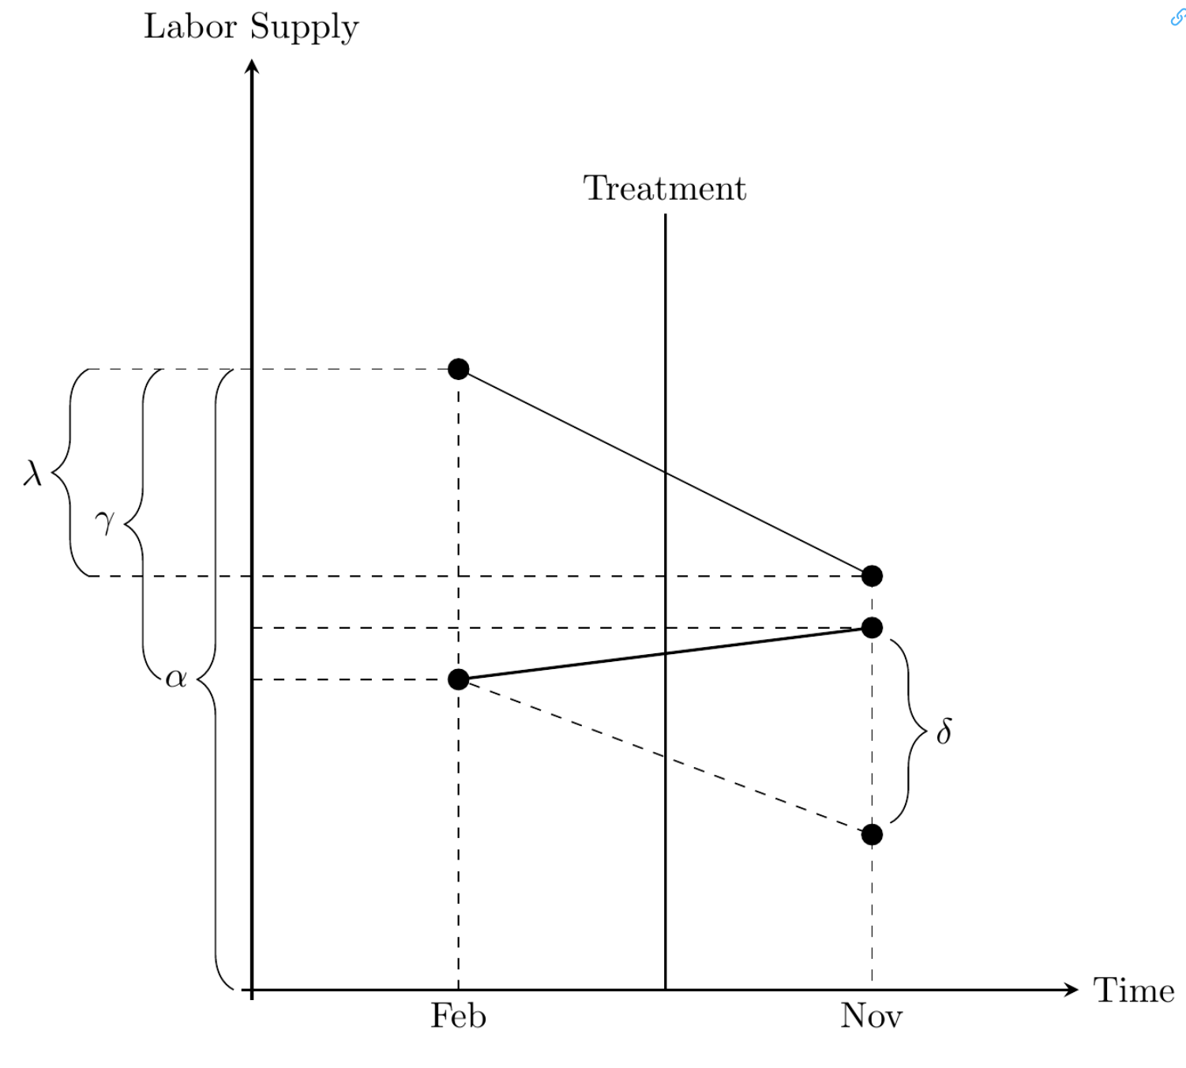
Sample Average vs Regressions
We use the trend in the control to get the counterfactual for the treatment group for $E[Y_{k}^{0}|Post]$
The parallel trends assumption is key here

Slide 31
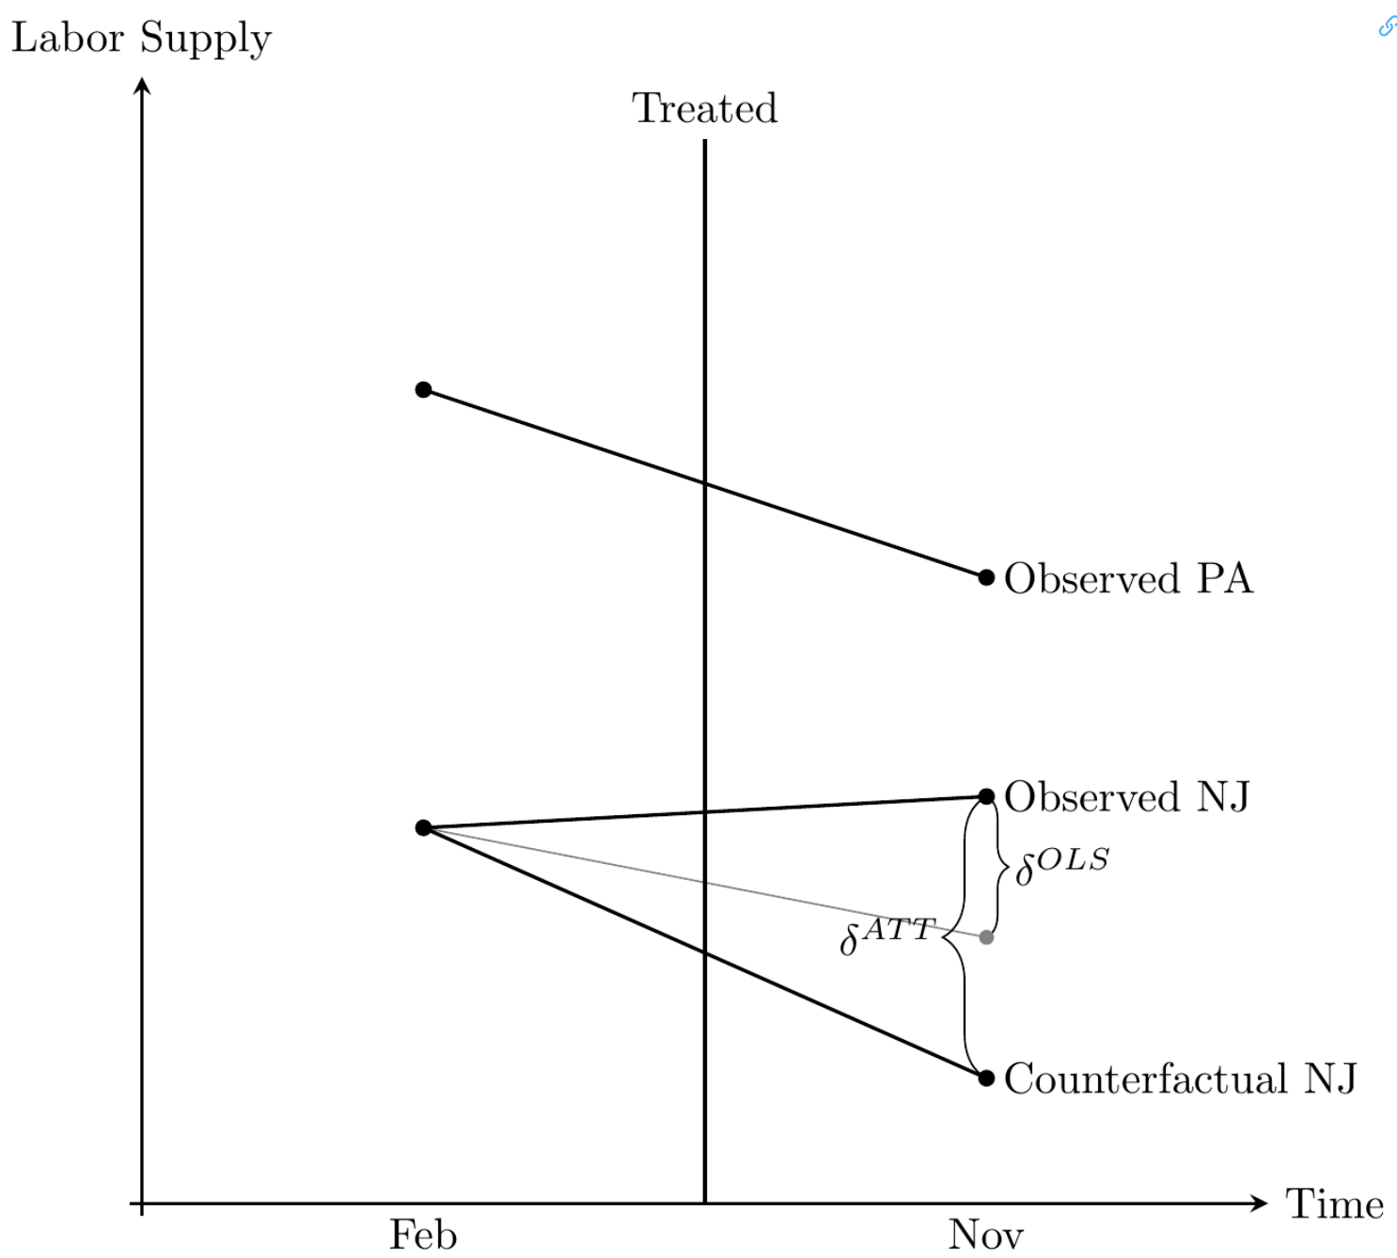
Sample Average vs Regressions
Note: OLS will still estimate the DD estimator even if the parallel trends assumption does not hold
If Pennsylvania is not a true counterfactual trend of New Jersey, then the DD estimator will be biased
$${\overset{̂}{δ}}_{kU}^{2x2}=ATT+Bias$$
The Parallel Trends assumption is just a restatement of the strict exogeneity assumption

Slide 32
Inference
Difference-in-Differences

Slide 33
Inference
Difference-in-Differences
2 Issues with Diff-in-Diff Inference
1) Errors are correlated within groups, typically at the state level
Bertrand, Duflo, and Mullainathan (2004) note that conventional standard errors will understate the standard deviation of the estimator and more likely to commit a Type I error (reject a true null)
2) Conley and Taber (2011) mention the problem of small clusters
When we cluster at the state level and 1 or a few states adopt the treatment, then standard errors will be inconsistent and downward biased (Type 1 Error)

Slide 34
Inference
Difference-in-Differences
1) Bertrand, et al. (2004) propose three methods to deal with serial correlations within large clusters
Block bootstrapping standard errors
bootstrapping at with replacement at the cluster level (usually state)
Aggregating data into one pre and one post period
Clustering standard errors at the treatment level (usually state)
Can be implemented easily with Stata
Small clusters are still a problem discussed next

Slide 35
Inference
Difference-in-Differences
2) What to do when we have small clusters?
Cunningham (2021) suggests using randomized inference
Conley and Taber (2011) suggest 2-stage estimates of standard errors
Cameron and Miller (2015) suggest using synthetic control method
Santa’Anna Updates
Ferman and Pinto (2019) suggest using bootstrap-based inference
Hagemann (2020) suggest using rearrangement permutation-based method
Canay, Santos, and Shaikh (2021) suggest using cluster wild bootstrap

Slide 36
Testing Assumptions
Difference-in-Difference 2x2 case

Slide 37
Testing Assumptions
Difference-in-Difference 2x2 case
There are four indirectly tests for the parallel trends assumption
1) Plotting pre-treatment trends
2) Pre-treatment trends - Event Studies
3) Placebo or falsification tests
4) Triple Difference-in-Difference-in-Differences
Remember if the parallel trends assumption fails
$${\overset{̂}{δ}}_{kU}^{2x2}=ATT+NonParallelTrendBias$$
We never observe the counterfactual $E[Y^{0}|Post]$

Slide 38
Testing Assumptions
Problems with testing pre-treatment trends
Let’s discuss the problem of testing pre-treatment trends
If the parallel trends assumption fails, our estimator is biased
We can never directly test the parallel trends assumption
Justification for using pre-treatment trends
If they were similar trends before the treatment, then they should be similar in the absence of the treatment group adopting the policy/program/treatment
However, just because treatment and control were similar in the past does not mean they will be the same other than treatment in the post period
This is a reason to use placebo tests and falsification tests

Slide 39
Testing Assumptions
Problems with testing pre-treatment trends
Another problem with testing pre-treatment trends
Is there self-selection with the treatment?
You cannot be vigilant enough with being cautious of your control groups, especially for states
$(Y^{1},Y^{0})⊥D$ needs to hold
E.g.: Texas and California will self-select into different types of treatment/policies/programs
Pre-treatment trends will not find this
If you have poor control group, the error term will be endogenous with the treatment

Slide 40
Testing Assumptions
Plotting pre-treatment trends
Show the data
You can provide pre-treatment data for treatment and control
You can inspect the summary statistics of the pre-treatment trends
Plot the data
You can simply plot the pre-treatment trends and visually inspect
This usually requires lots of graphs in the appendix but it is transparent
If there are a lot of treatment groups, this test gets harder to implement

Slide 41
Testing Assumptions
Pre-treatment trends - Event Studies
We can check pre-treatment and post-treatment differences between treatment and control with Event Studies for each time period
Add pre-treatment leads and post-treatment lags for each time period
Pre-treatment leads should be statistically insignificant between treatment and control since the treatment group has not received the treatment
Pro:
You plot coefficients of the regression instead of raw data
Con
Does not work if one of your control groups adopts a similar post in post-treatment

Slide 42
Testing Assumptions
Pre-treatment trends - Event Studies
We can check pre-treatment and post-treatment differences between treatment and control with Event Studies for each time period
Add pre-treatment leads and post-treatment lags for each time period
Pre-treatment leads should be statistically insignificant between treatment and control since the treatment group has not received the treatment
Pro:
You plot coefficients of the regression instead of raw data
Con
Does not work if one of your control groups adopts a similar post in post-treatment

Slide 43
Event Studies
Miller, Altekruse, Johnson, and Wherry (2019)
Miller, Altekruse, Johnson, and Wherry (2019) test the impact of the Medicaid expansion under the Affordable Care Act (ACA)
Were there any impacts on mortality outcomes?
We saw earlier that there were some doubts about Medicaid’s expansion on mortality from Finkelstein, et al. (2012) and Baicker, et al. (2013) using instrumental variable estimators for the Oregon Medicaid Lottery
These authors revisit the question with a larger set of data and more states
They link a large-scale federal survey with admin data on death
The authors find that Medicaid expansion reduces annual mortality rates by 0.13 percentage points (9.3% reduction in the sample mean)

Slide 44
Event Studies
Miller, Altekruse, Johnson, and Wherry (2019)
Most contemporary DD studies utilize pre-treatment leads instead of plotting the raw data
Including both pre-treatment leads and post-treatment allows readers to check
Post-treatment dynamics were different between treatment and control
Pre-treatment dynamics were similar between treatment and control
Event Study Model
$$Y_{its}=γ_{s}+λ_{t}+\overset{-1}{\underset{τ=-q}{∑}}γ_{τ}D_{sτ}+\overset{m}{\underset{τ=0}{∑}}δ_{τ}D_{sτ}+x_{its}+ε_{its}$$

Slide 45
Event Studies
Miller, Altekruse, Johnson, and Wherry (2019)
$$Y_{its}=γ_{s}+λ_{t}+\underset{\text{pre-treatment leads}}{\underset{⏟}{\overset{-1}{\underset{τ=-q}{∑}}γ_{τ}D_{sτ}}}+\underset{\text{post-treatment lags}}{\underset{⏟}{\overset{m}{\underset{τ=0}{∑}}δ_{τ}D_{sτ}}}+x_{its}+ε_{its}$$
Treatment occurs when $τ=0$
There are $q$ leads or (pre-treatment) anticipatory effects
There are $m$ lags or post-treatment effects
We should expect no impacts of pre-treatment leads or no anticipatory effects

Slide 46
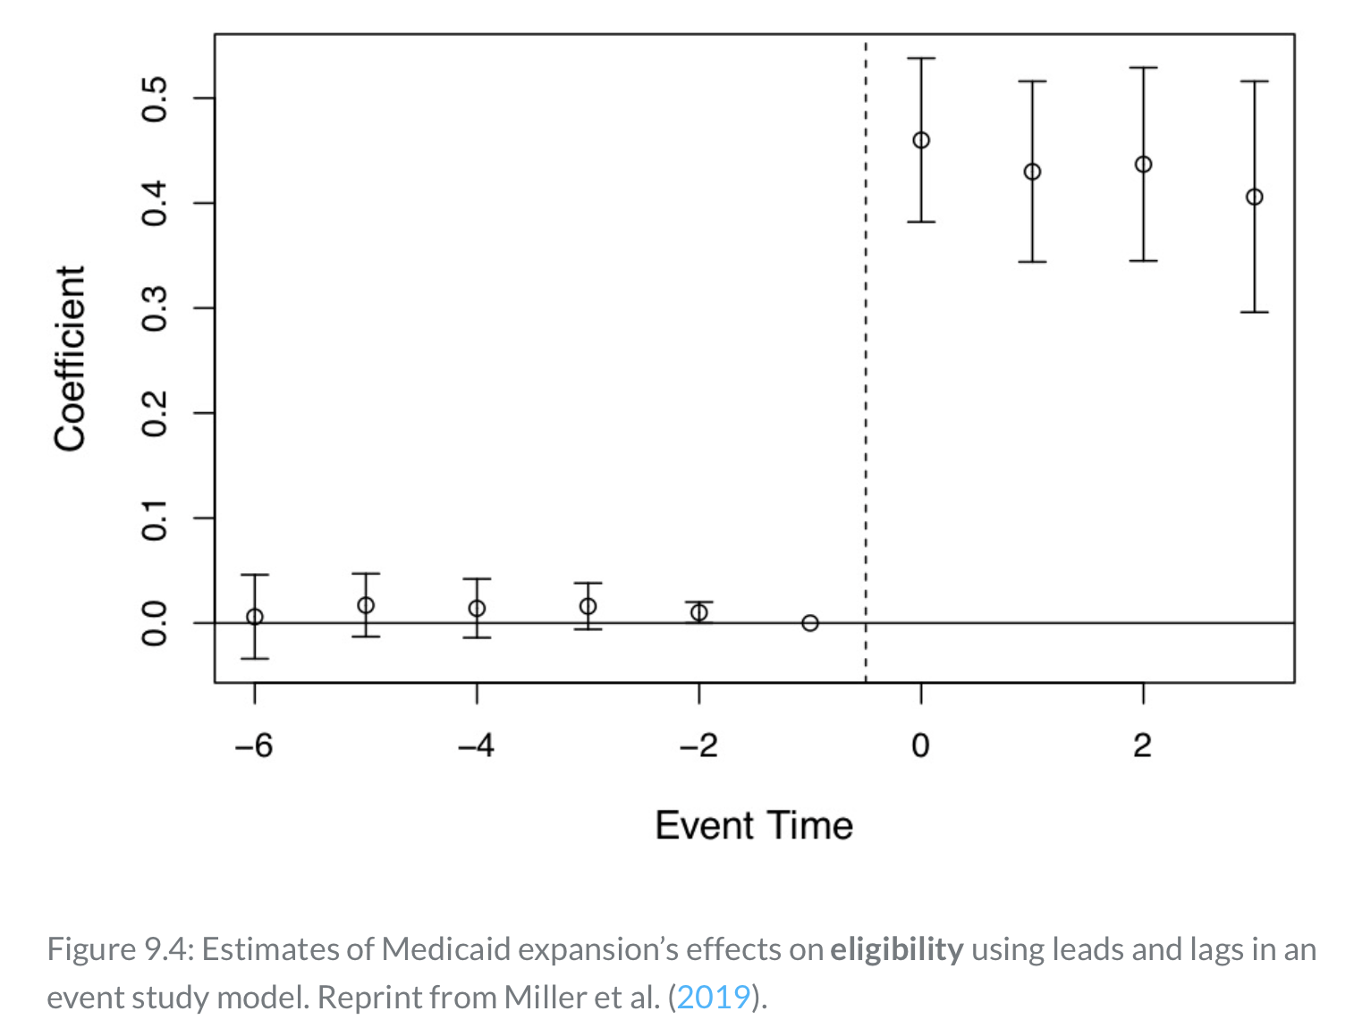
Event Studies
Miller, Altekruse, Johnson, and Wherry (2019)
The first stage would be that the policy affects Medicaid eligibility
ACA Medicaid expansions shows a clear impact on eligibility
We see no difference between treatment and control in the pre- treatment leads, but differences in the post-treatment lags

Slide 47
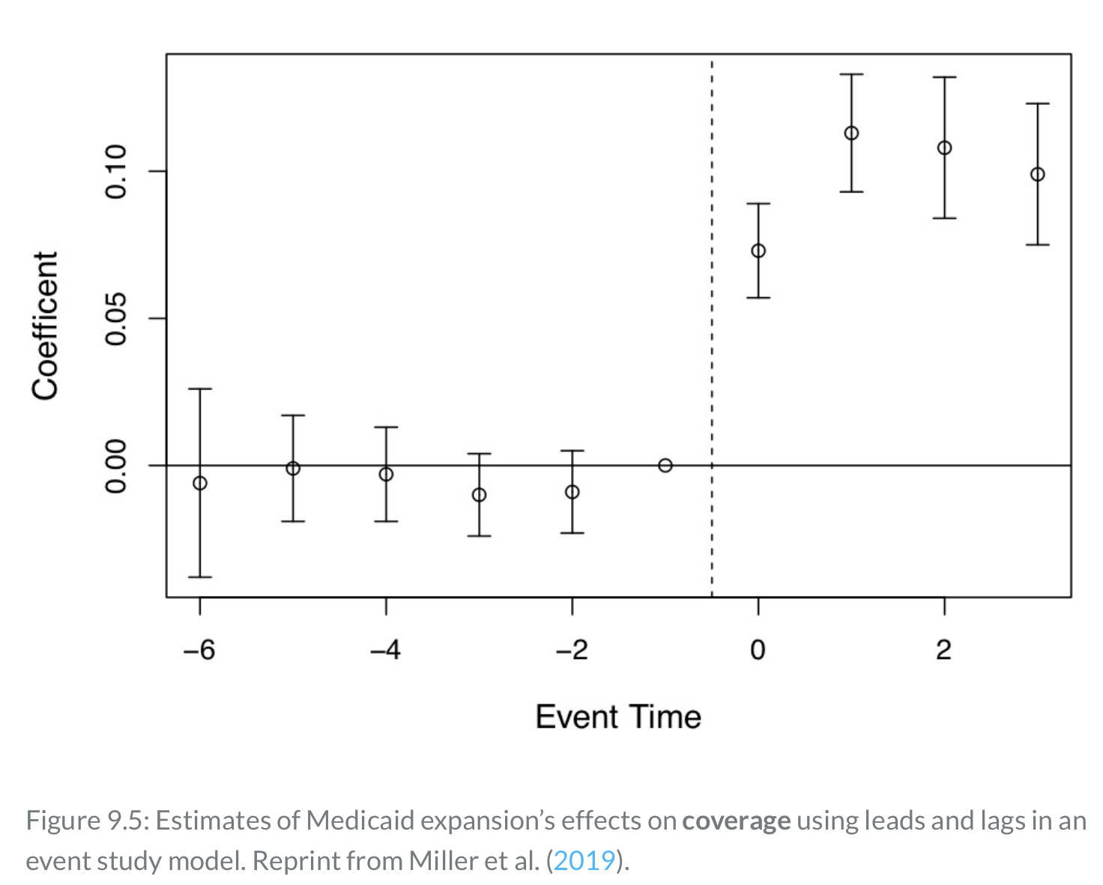
Event Studies
Miller, Altekruse, Johnson, and Wherry (2019)
Another first stage test is the ACA Medicaid expansion’s impact on coverage
There are no significant differences in the pre-treatment leads, but we see statistically significant differences in the post-treatment lags

Slide 48
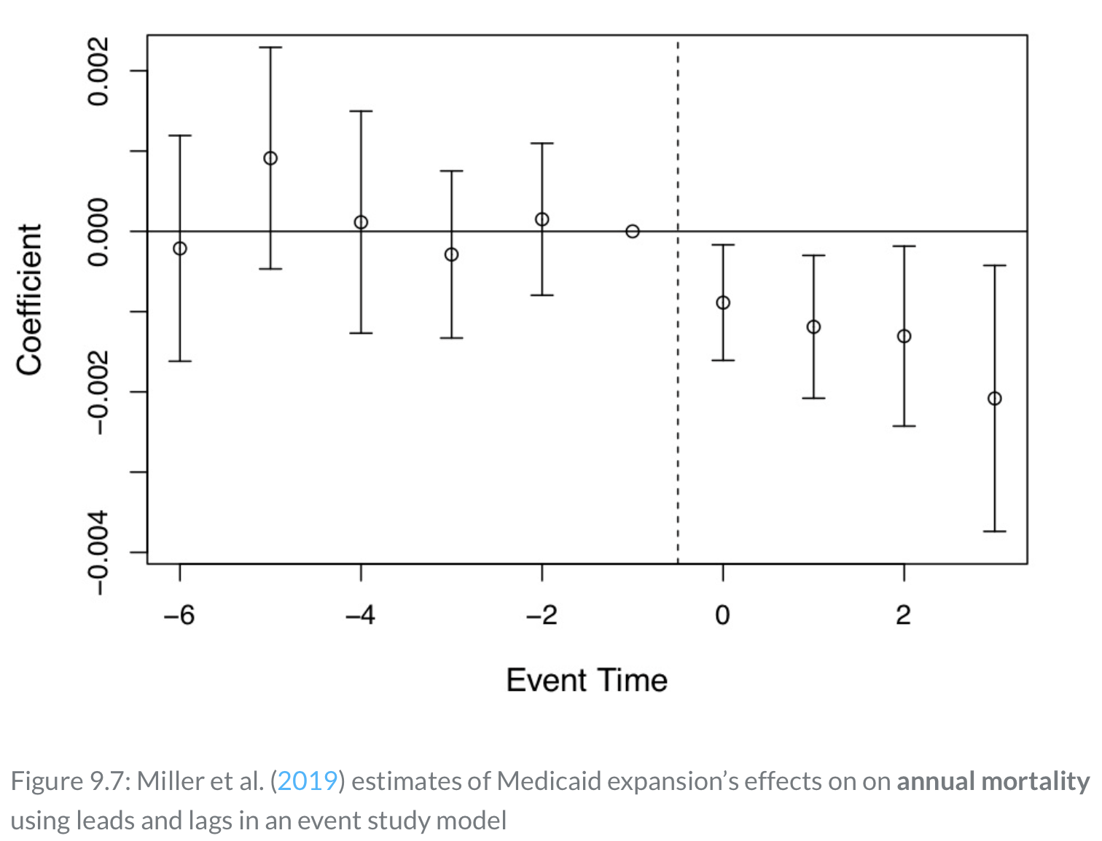
Event Studies
Miller, Altekruse, Johnson, and Wherry (2019)
The main result for the authors assess the the impact of ACA’s Medicaid expansion on annual mortality rate
If the parallel trends assumption holds, then ACA’s Medicaid expansion lead to a 0.13 percentage point decline in annual mortality rate, which translates to a 9.3% reduction

Slide 49
Event Studies
Miller, Altekruse, Johnson, and Wherry (2019)
Note: Just because the pre-treatment leads are not statistically significant, does not mean that the control group is a true counterfactual of the treatment group
However, it is compelling that there is “bite” in the 1st stage, such that Medicaid expansion increases eligibility & coverage while reducing uninsured

Slide 50
Testing Assumptions
Placebo and Falsification Tests
Placebo tests can be used as a robustness check
These are essential in contemporary DD analysis for indirect tests of the parallel trends assumption
Our Stata example will provide a nice example of how a preliminary result can fail robustness checks
Placebo tests strengthen our main DD analysis
Being unable to reject the null hypothesis of the placebo boost your main result
You may have picked up a spurious correlation in your main result
Such as cyclical factors or other time-varying unobserved confounders and testing falsification and placebo tests help prevent this

Slide 51
Testing Assumptions
Placebo and Falsification Tests
There are three types of Placebo tests we will discuss
1) False time adoption of treatment
2) Placebo test for control group that did not receive the treatment
3) Triple Difference-in-Difference-in-Differences
Sometimes researchers use Triple DDD as a main analysis

Slide 52
Testing Assumptions
Placebo and Falsification Tests
False Time Adoption (Falsification)
We can conduct an diff-in-diff design for the treatment and control groups, but in a time period before the policy, program, or treatment is adopted
Let’s a program is implemented in 2015, we would want to test the impact of a false adoption time in 2010 (5 years before adoption)
We should not expect any significant differences between treatment and control
If we do find differences, then we need to reconsider our original DD design

Slide 53
Testing Assumptions
Placebo and Falsification Tests
Another test if a placebo test for a group that did not receive treatment
For example, supervisory and managerial workers should not be directly affected by a unionization program treatment
Another example are high wage workers that should not be directly affected by a minimum wage policy. In Card and Krueger (1994), high wage workers should not be affected by the NJ minimum wage increase
You can also try applying a treatment placebo to a group that was in control
You know that a particular state did not adopt a program or policy, then you can test that state as the treatment state in a placebo test

Slide 54
Testing Assumptions
Triple Difference-in-Difference-in-Differences
Similar to the last placebo test, we will test a triple difference-in-difference-in-differences or Triple DDD
The basis
We will apply our difference-in-difference to 2 subgroups within the treatment group
A subgroup within treatment that will be affected by the program
A subgroup within treatment that will not be affected by the program
The subgroup that should not be impacted by the program should be unable to reject the null hypothesis

Slide 55
Testing Assumptions
Triple Difference-in-Difference-in-Differences
DDD Estimator
$$Y_{ijt}=α+ψX_{ijt}+β_{1}τ_{t}+β_{2}δ_{j}+β_{3}D_{i}+β_{4}(δ×τ)_{jt}+β_{5}(τ×D)_{ti}+β_{6}(δ×D)_{ji}+β_{7}(δ×τ×D)_{ijt}+ε_{ijt}$$
All interactions are included in a DDD design
Group dummy $δ_{j}$
Post-treatment dummy $τ_{t}$
Treatment group dummy $D_{i}$
$X_{ijt}$ is a set of covariates of interest

Slide 56
Testing Assumptions
Triple Difference-in-Difference-in-Differences
$$Y_{ijt}=α+ψX_{ijt}+β_{1}τ_{t}+β_{2}δ_{j}+β_{3}D_{i}+β_{4}(δ×τ)_{jt}+β_{5}(τ×D)_{ti}+β_{6}(δ×D)_{ji}+β_{7}(δ×τ×D)_{ijt}+ε_{ijt}$$
Our parameter of interest is $β_{7}$ to compare to our original DD
If our original DD estimate is robust, the $β_{7}$ should be similar to our original estimate
Our other coefficient of interest is $β_{5}$
This is the DD estimator for the placebo subgroup (or the subgroup in the treatment group that does not get the treatment)
This should be statistically insignificant

Slide 57
Testing Assumptions
Triple Difference-in-Difference-in-Differences
Let’s go back to our Card and Krueger (1994) example
We had our treatment state NJ $(D_{i})$and our control state PA
We had our pre-period February 1992 and our post-period November 1992 $(τ_{t})$
Now look at low-wage workers and high-wage workers $(δ_{j})$
High-wage workers should not be directly impacted by the increase in minimum wage laws

Slide 58
Testing Assumptions
Triple Difference-in-Difference-in-Differences
Before the treatment, we have 4 fixed groups
$NJ_{low}$ low-wage workers in New Jersey (treatment)
$NJ_{high}$ high-wage workers in New Jersey (treatment)
$PA_{low}$ low-wage workers in Pennsylvania (control)
$PA_{high}$ high-wage workers in Pennsylvania (control)

Slide 59
Testing Assumptions
Triple Difference-in-Difference-in-Differences
After the treatment, we have 4 changes for New Jersey (treatment) low-wage workers
$T$ national (secular) trends that cause employment to change
$NJ_{t}$ is New Jersey specific time shocks to employment
$l_{t}$ is generic low-wage worker trends that cause employment to change
$D$ is the impact of the treatment (minimum wage)

Slide 60
Testing Assumptions
Triple Difference-in-Difference-in-Differences
After the treatment, we have 3 changes for Pennsylvania (control) low-wage workers
$T$ national (secular) trends that cause employment to change
$PA_{t}$ is Pennsylvania specific time shocks to employment
$l_{t}$ is generic low-wage worker trends that cause employment to change

Slide 61
Testing Assumptions
Triple Difference-in-Difference-in-Differences
After the treatment, we have 3 changes to New Jersey (treatment) high-wage workers (placebo)
$T$ national (secular) trends that cause employment to change
$NJ_{t}$ is New Jersey specific time shocks to employment
$h_{t}$ is generic high-wage worker trends that cause employment to change
After treatment, we have 3 change to Pennsylvania (control) high-wage workers
$T$ national (secular) trends that cause employment to change
$PA_{t}$ is Pennsylvania specific time shocks to employment
$h_{t}$ is generic high-wage worker trends that cause employment to change

Slide 62
Testing Assumptions
Triple Difference-in-Difference-in-Differences
States | Group | Before | After | First Difference | Second Difference | Third Difference
NJ | Low
 | High
PA | Low
 | High
$$NJ_{low}$$
$$NJ_{low}+T+NJ_{t}+l_{t}+D$$
$$T+NJ_{t}+l_{t}+D$$
$$(l_{t}-h_{t})+D$$
$$D$$
$$NJ_{high}$$
$$NJ_{high}+T+NJ_{t}+h_{t}$$
$$T+NJ_{t}+h_{t}$$
$$PA_{low}$$
$$PA_{low}+T+PA_{t}+l_{t}$$
$$T+PA_{t}+l_{t}$$
$$(l_{t}-h_{t})$$
$$PA_{high}$$
$$PA_{high}+T+PA_{t}+h_{t}$$
$$T+PA_{t}+h_{t}$$

Slide 63
Testing Assumptions
Triple Difference-in-Difference-in-Differences
Our first difference
Takes care of fixed effects
We still have confounders of such as $T$, $NJ_{t}$, $PA_{t}$, $h_{t}$, $l_{t}$
Our second difference
Takes care of trends $T$, $NJ_{t}$, $PA_{t}$
We still have confounders $l_{t}-h_{t}$
Our third difference
Takes care of $l_{t}-h_{t}$
Identifies the causal effects if the parallel trends assumption holds

Slide 64
Difference-in-Difference Examples
Diff-in-Diff and Triple Difference Examples

Slide 65
Difference-in-Difference-in-Differences
State-Mandated Maternity Benefits
Gruber (1994) introduced the Triple Difference design
The author studied state-mandated maternity benefits on hourly wages
Gruber uses a Triple Difference to check to robustness of the Diff-in-Diff
When we do a Triple difference design, the variation should come from the treatment group (and focus subgroup) and not the control group (or placebo group)
Gruber’s treatment subgroup is women in child-bearing age, while the placebo subgroup is men 20-40 and women over 40

Slide 66
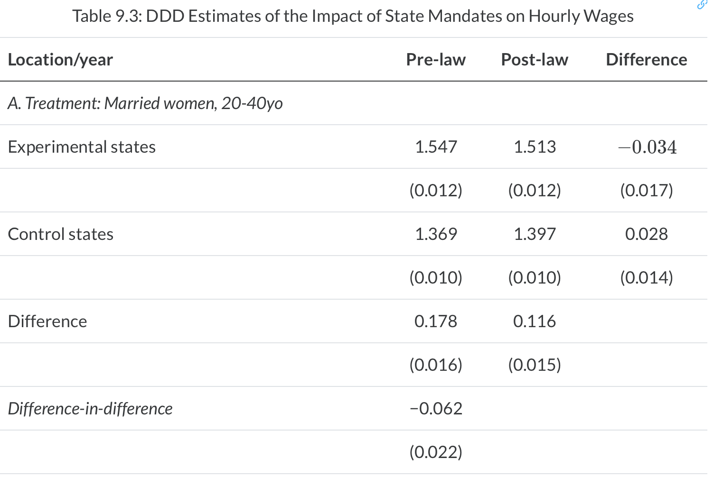
Difference-in-Difference-in-Differences
State-Mandated Maternity Benefits
Gruber (1994) results show that women in child- bearing age had a loss of hourly wages of 6%

Slide 67
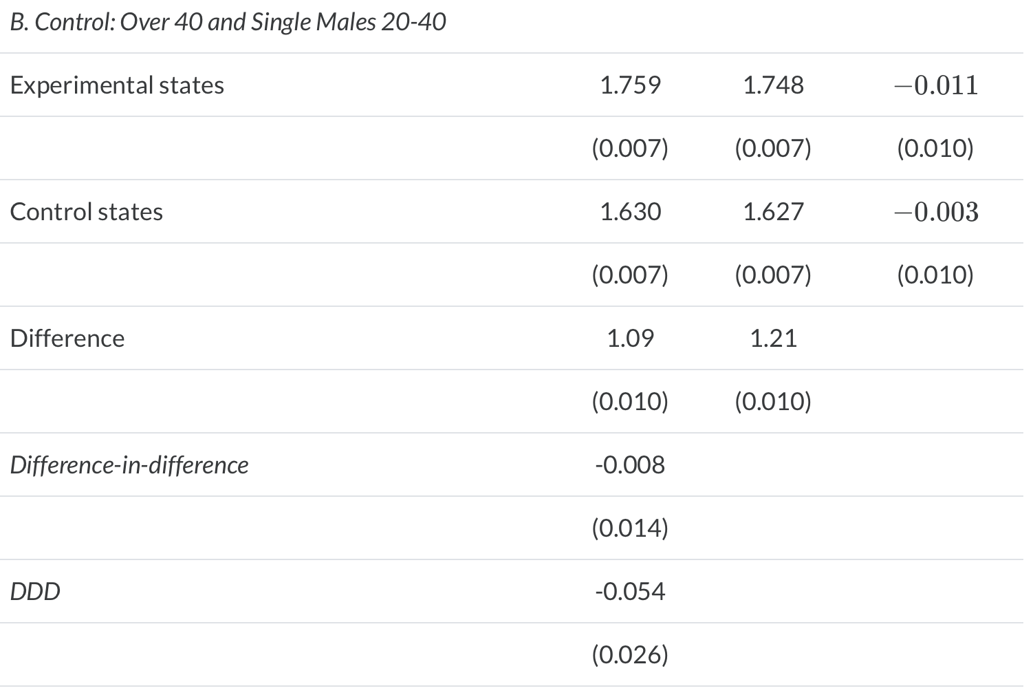
Difference-in-Difference-in-Differences
State-Mandated Maternity Benefits
Gruber (1994) Triple Difference check shows that Diff-in-Diff for women 40 and older and men 20-40 had a statistically insignificant impact on hourly wages from mandated maternity benefits
However, women 20-40 had a reduction in hourly wages of 5.3%

Slide 68
Difference-in-Difference Example
Abortion Legalization and Incidence of Gonorrhea
Stata Example
Cunningham and Cornwell (2013) assess the impact of abortion legalization on long-term incidences of gonorrhea
This research builds off of the reproductive health literature and the abortion legalization hypothesis
Gruber, Levine, and Staiger (1999) look at characteristics of the marginal child that was aborted
Donohue and Levitt (2001) test abortion legalization and crime

Slide 69
Difference-in-Difference Example
Abortion Legalization and Incidence of Gonorrhea
Donohue and Levitt (2001) test the abortion legalization hypothesis
Abortion legalization hypothesis says that the availability of abortion reduces children born in high-risk of committing a crime
They find that abortion legalization reduced crime lead to a decrease in crime
Levitt (2004) finds that abortion legalization led to about a 10% decline in crime between 1991 and 2001

Slide 70
Difference-in-Difference Example
Abortion Legalization and Incidence of Gonorrhea
Joyce (2004,2009) and Foot and Goetz (2008) dispute the results
Joyce (2009) challenges long-term changes from legalized abortion through a Triple DDD
Joyce argues that if there was extreme negative selection for crime, then it should show up everywhere not just in crime
“If abortion lowers homicide rates by 20-30%, then it is likely to have affected an entire spectrum of outcomes associated with well-being: infant health, child development, schooling, earnings, and marital status. Similarly, the policy implications are broader then abortion. Other interventions that affect fertility control and that lead to fewer unwanted births—contraception or sexual abstinence—have huge potential payoffs. In short, a causal relationship between legalized abortion and crime has such significant ramifications for social policy and at the same time is so controversial, that further assessment of the identifying assumptions and their robustness to alternative strategies is warranted. (p.112)”

Slide 71
Difference-in-Difference Example
Abortion Legalization and Incidence of Gonorrhea
Cunningham and Cornwell (2013) takes up Joyce (2009) challenge by testing legalized abortion with long-run incidences of gonorrhea
Single-parent households have a higher risk of sexual activity and unprotected sex Levine, et al. (1999)
Charles and Stephen (2006) find that child exposed to legalized abortion were less likely to use illegal substances, which is linked with sexual activity
Cunningham and Cornwell (2013) use a difference-in-difference design as opposed to Donohue and Levitt (2001) that use lagged ratio values at the state level

Slide 72
Difference-in-Difference Example
Abortion Legalization and Incidence of Gonorrhea
Cunningham makes a good point about theories
Good theories provide very specific falsifiable hypotheses
More specific the hypothesis, the more compelling the theory if evidence supports the theory
The theory of abortion legalization makes very specific hypotheses
If we find evidence of the hypothesis, we have to take the theory seriously
What are usually yet testable predictions from the abortion legalization theory?

Slide 73
Difference-in-Difference Example
Abortion Legalization and Incidence of Gonorrhea
Cunningham and Cornwell (2013) argue that the abortion legalization theory predicts the shape of the effects with staggered adoption
5 states legalized abortion and then all states are exposed to legalized abortion
There is a three-year lag between the 5 states and Roe v Wade decision
The shape should be nonlinear parabolic treatment effect
There should be increasingly negative effect of abortion legalization on the outcome between the treatment states and control states
The treatment effects should recede after the control states are forced to legalize abortion

Slide 74
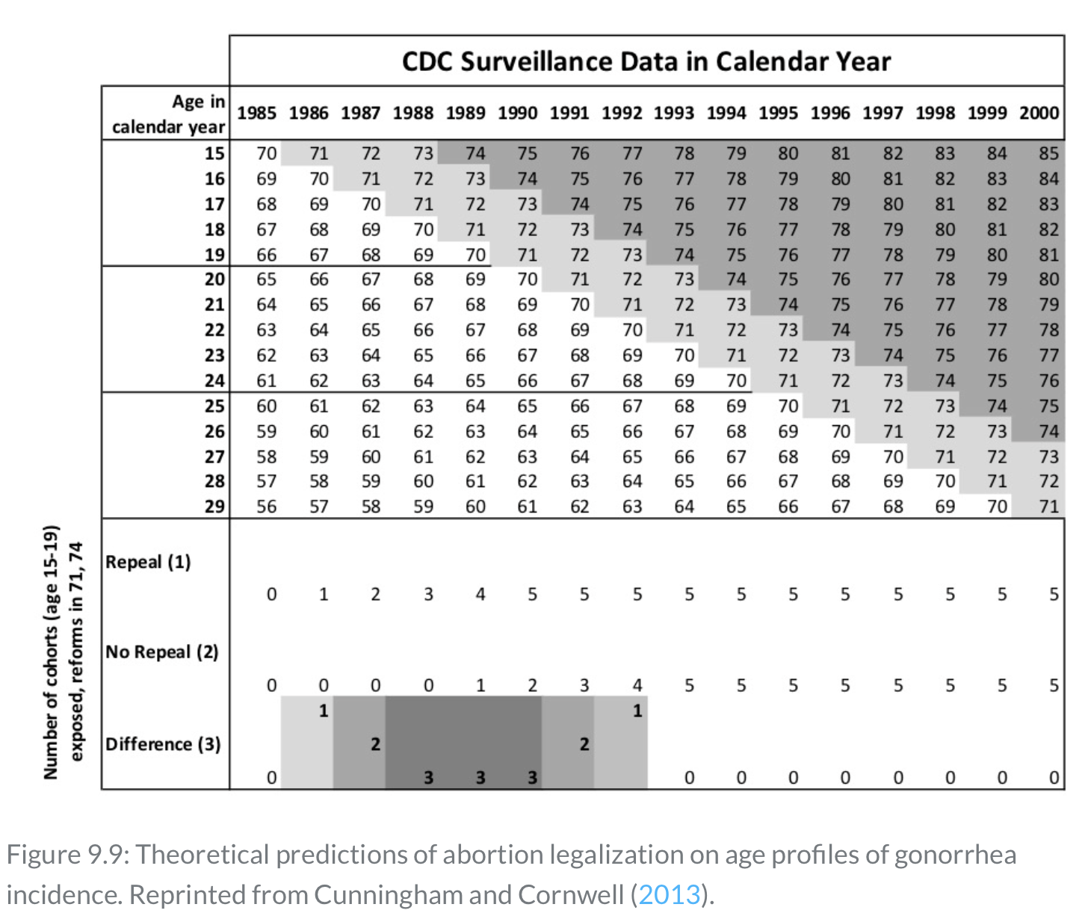
Difference-in-Difference Example
Abortion Legalization and Incidence of Gonorrhea
The authors use age cohorts due to data limitations
For 15-19 year olds born between 1971-1973, there should be increasingly negative treatment effects for this cohort from 1986-1987
A plateau treatment effect between 1988-1991
And a weakening treatment effects between 1991-1992

Slide 75
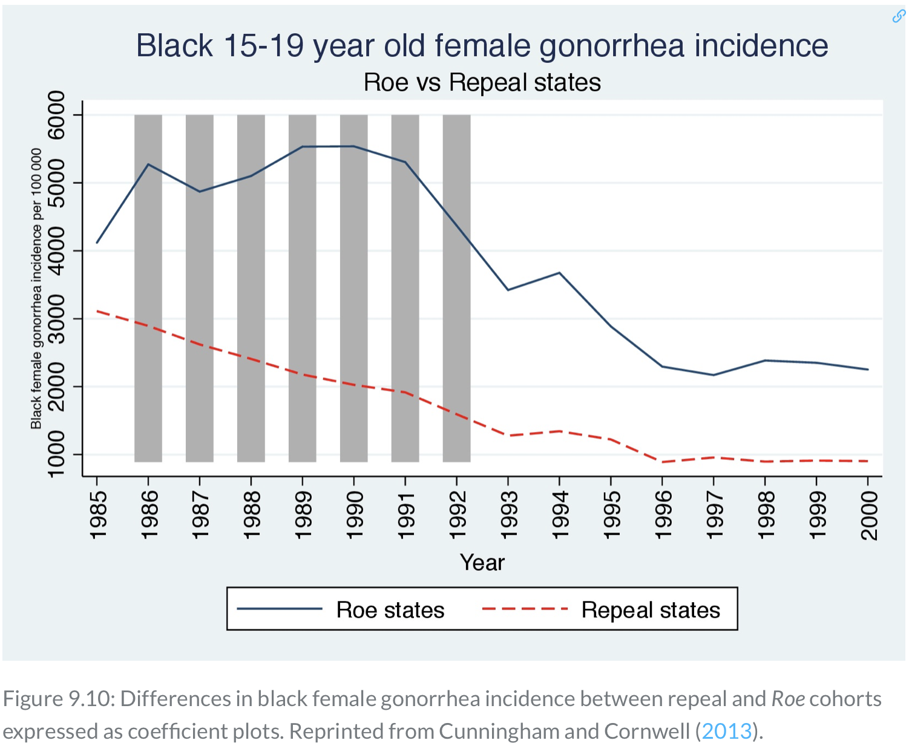
Difference-in-Difference Example
Abortion Legalization and Incidence of Gonorrhea
There should be two testable hypotheses with a staggered rollout
Are there treatment effects during the transition period?
Are there no treatment effects after the transition period?
Plotting the raw data can be seen where treatment states have declining rates of gonorrhea between 1986 and 1992

Slide 76
Difference-in-Difference Example
Abortion Legalization and Incidence of Gonorrhea
Main model
$$Y_{st}=β_{1}Repeal_{s}+β_{2}DT_{t}+β_{3}(Repeal×DT)_{st}+ψX_{st}+αDS_{s}+ε_{st}$$
Where
$Y_{st}$ is the outcome of interest - new gonorrhea cases for 15-19 year olds per 100,000
$Repeal_{s}$ equal 1 if the state legalized abortion before Roe v Wade
$DT_{t}$ is a year dummy
$DS_{s}$ is a state-specific dummy
$X_{st}$ are a set of covariates

Slide 77
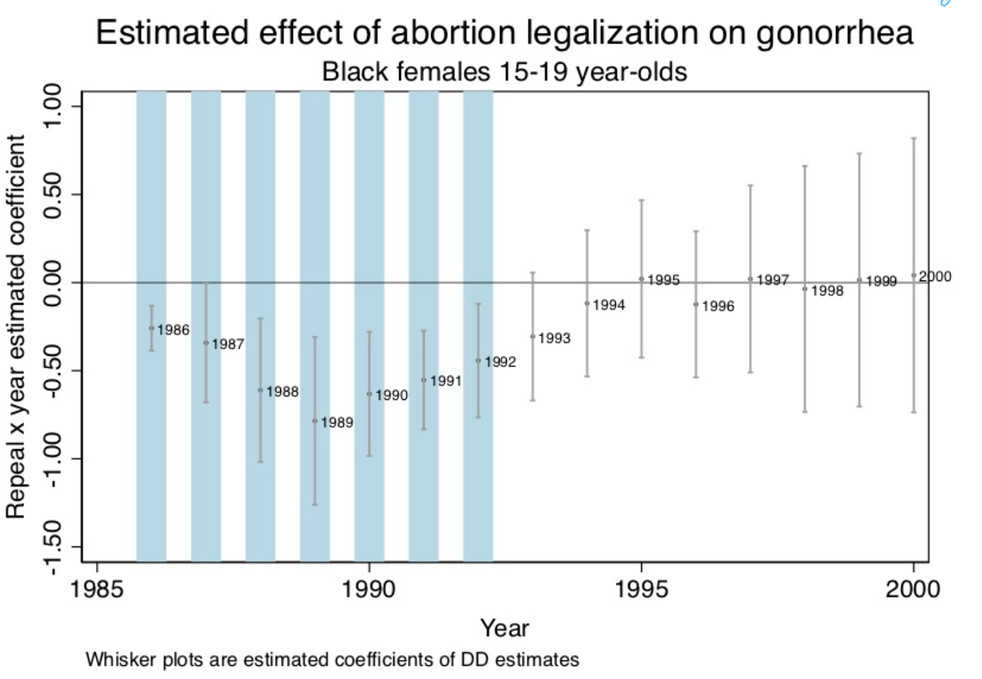
Difference-in-Difference Example
Abortion Legalization and Incidence of Gonorrhea
Cunningham and Cornwell (2013) provide the DD estimates by year
A parabolic shape is seen between 1986 and 1992
The effect is no longer significant after 1992
This does give evidence for the abortion legalization hypothesis

Slide 78
Difference-in-Difference Example
Abortion Legalization and Incidence of Gonorrhea
Cunningham does placebo tests on his own work using a Triple DDD to rule out alternative hypotheses
Triple DDD
He choses a group close to 15-19 year olds for trends, but not close enough for SUTVA spillovers
25-29 year olds were the placebo group within treatment states
$Y_{ast}=β_{1}Repeal_{s}+β_{2}DT_{t}+β_{3}(Repeal×DT)_{st}+δ_{1}DA_{a}+δ_{2}(Repeal×DA)_{sa}+$ $δ_{3}(DA×DT)_{at}+δ_{4}(DA×Repeal×DT)_{ast}+α_{1}DS_{s}+alpha_{2}(DS×DA)_{sa}+$ $ψX_{ast}+γ_{1}t+γ_{2}(DS×t)_{st}+γ_{3}(DA×t)_{at}+γ_{4}(DA×DS×t)_{ast}+ε$
Our treatment of interest is $δ_{4}$

Slide 79
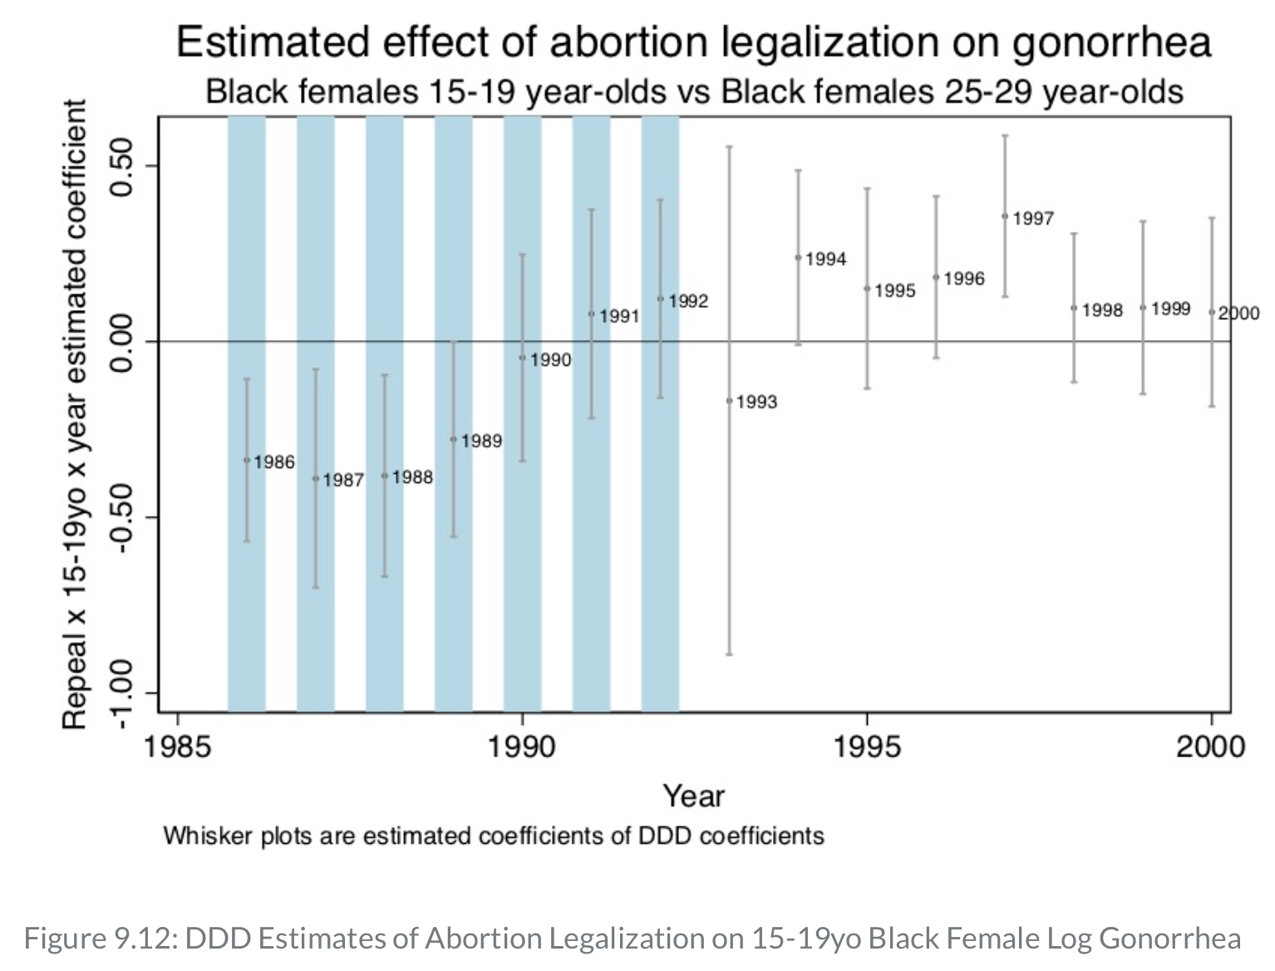
Difference-in-Difference Example
Abortion Legalization and Incidence of Gonorrhea
The prediction begins to break down with the DDD placebo tests
There are statistically significant impacts between 1986 and 1989, but no difference between treatment and control groups after 1989
There is also no parabolic effect
Key: There might be some unobservable confounders in treatment states that are not in the Roe v Wade states

Slide 80
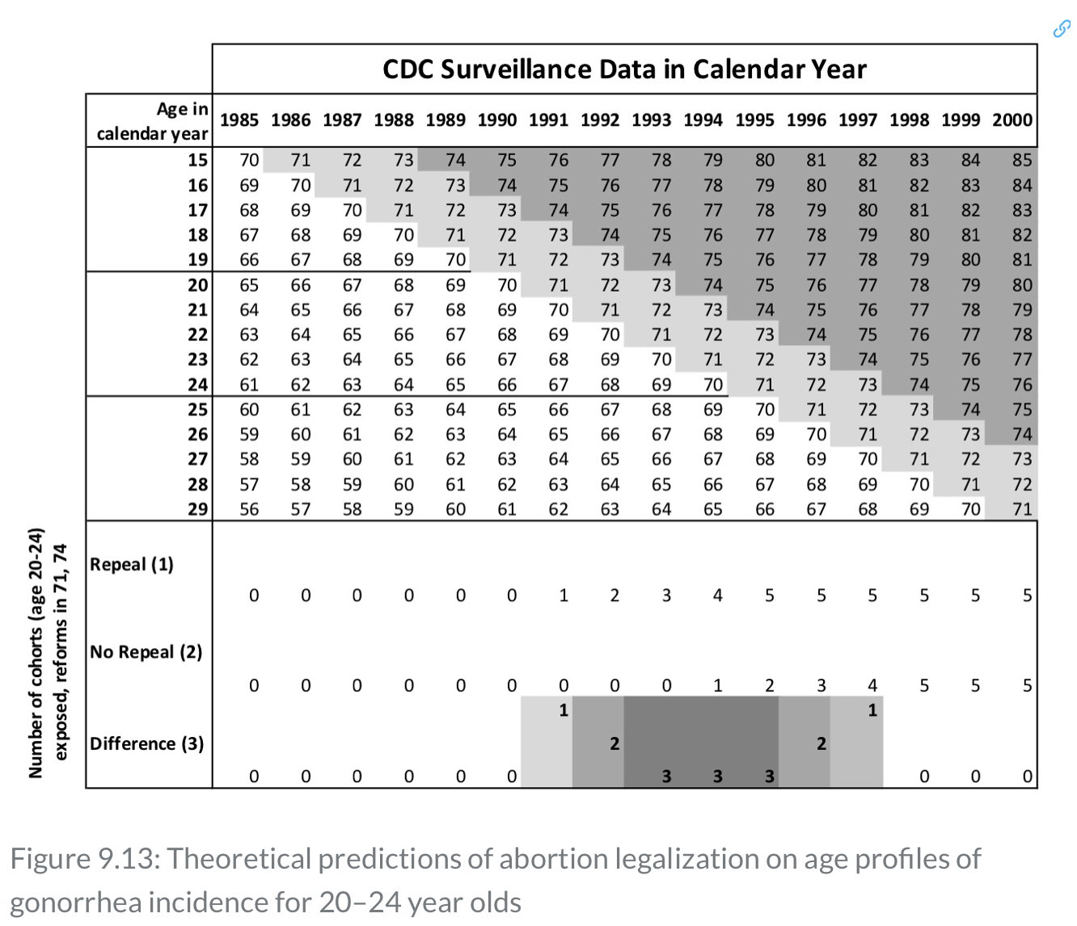
Difference-in-Difference Example
Abortion Legalization and Incidence of Gonorrhea
Cunningham then tests the DD estimator for 20-24 year olds who would have been exposed to legal abortion between 1991-1993 in treatment states
The treatment show grow between 1991 to 1993
The treatment show plateau between 1993 and 1995
The treatment show converge to zero between 1995 and 1997

Slide 81
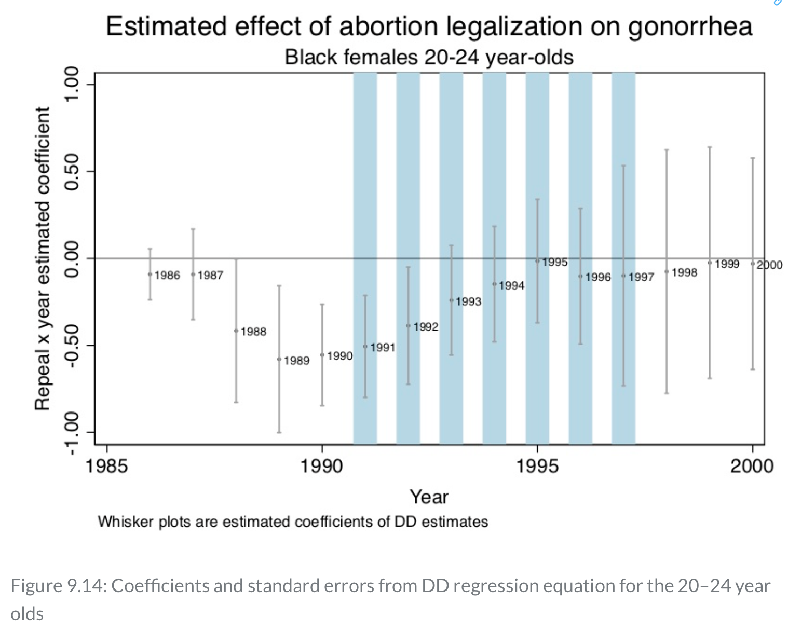
Difference-in-Difference Example
Abortion Legalization and Incidence of Gonorrhea
The prediction breaks down here as well for the 20-24 year olds
There is a parabolic effect but it occurs before the predicted time period
The impacts should show up in 1991, but they begin to appear in 1989
The impact become statistically insignificant in 1993 instead of 1998

Slide 82
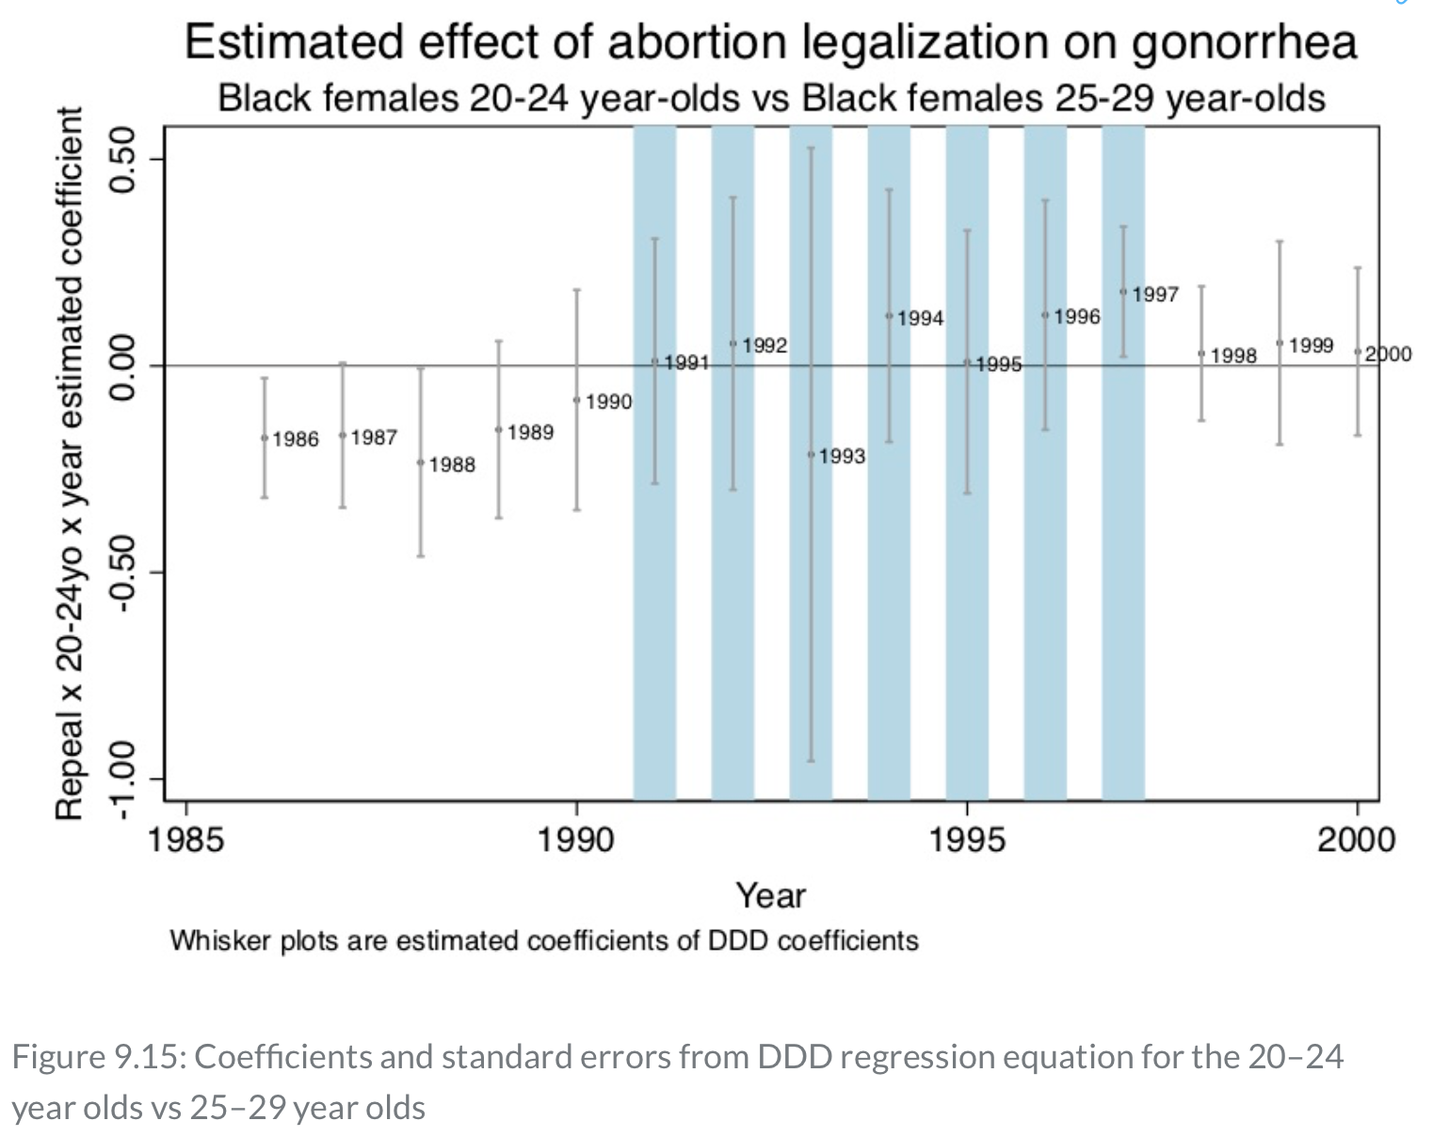
Difference-in-Difference Example
Abortion Legalization and Incidence of Gonorrhea
Cunningham tests a placebo Triple DDD comparing 20-24 year olds with 25-29 year olds
The prediction breaks down even more
The original design provided support the abortion legalization hypothesis, but additional tests show that there is little evidence

